Slide 1
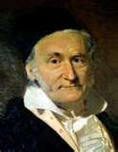
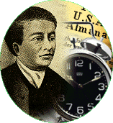
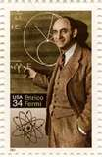
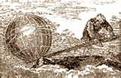
Math Blast
From the Past

Slide 2
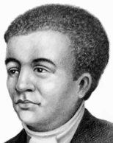
Benjamin Banneker
Maryland
1731-1806

Slide 3
Benjamin Banneker has been called the first African American intellectual.
Banneker taught himself astronomy and advanced mathematics and he began to devote serious attention to both subjects. He successfully predicted solar eclipse contradicting the forecasts of prominent mathematicians and astronomers of the day.

Slide 4
Benjamin was the son of Robert and Mary Bannaky. His grandfather was a slave and his grandmother, an indentured servant from England.
Life
When Benjamin’s grandmother finished her seven years of bondage, she bought a farm along with two slaves to help her take care of it. She freed both slaves and married one, Bannaky. They had several children, among them a daughter named Mary. When Mary Bannaky grew up, she bought a slave named Robert, married him and had several children, including Benjamin.
Molly, Banneker's grandmother, taught him to read, using her Bible as a lesson book. There was no school to attend. Then one summer, a Quaker school teacher came to live in the valley. He set up a school for boys. Benjamin Bannaky attended this school. The schoolmaster changed the spelling of his name to Banneker. At school he learned to write and do simple arithmetic.

Slide 5
Banneker's parents died, leaving him the farm. Banneker built a "work cabin" with a skylight to study the stars and make calculations. He spent most of the rest of his life at the farm.
Banneker never married. He died on Oct. 9, 1806, and was
buried in the family burial ground near his house.
Banneker's memory was kept alive by writers who described his achievements as the first African American scientist. Recent studies have verified Banneker's status as an extremely competent mathematician and amateur astronomer.

Slide 6
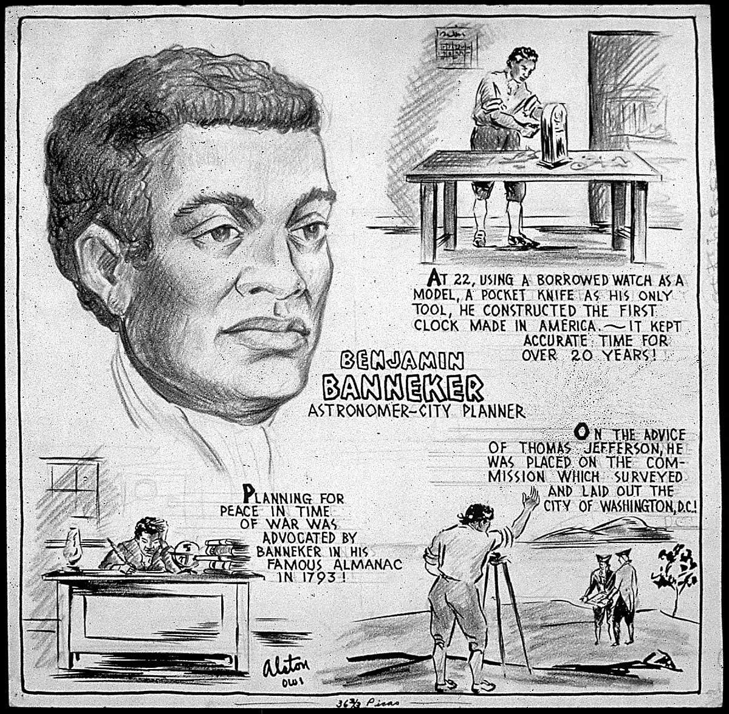
The "Sable Astronomer" was often pointed to as proof that African Americans were not intellectually inferior to European Americans. Thomas Jefferson himself noted this in a letter to Banneker.

Slide 7
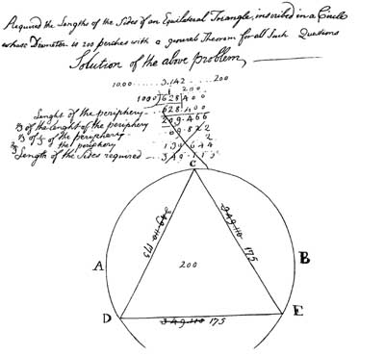
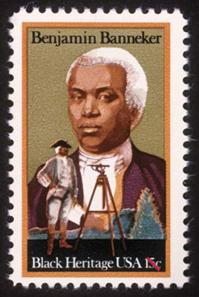
In 1980, the U.S. Postal
Service issued a postage
stamp in his honor.
Banneker taught himself astronomy
and advanced mathematics .

Slide 8
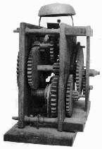
In 1753, the young man borrowed a pocket watch from a well-to-do neighbor; he took it apart and made a drawing of each component, then reassembled the
watch and returned it, fully functioning, to its owner.
From his drawings Banneker then proceeded to carve, out of wood, enlarged replicas of each part. Calculating the proper number of teeth for each gear and the necessary relationships between the gears, he constructed a working wooden clock that kept accurate time and struck the hours for over 50 years.

Slide 9
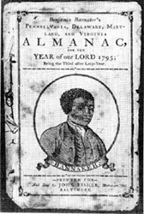
At age 58, Banneker began the study of astronomy and was soon predicting future solar and lunar eclipses. He compiled the ephemeris, or information table, for annual almanacs that were published for the years 1792 through 1797.
"Benjamin Banneker's Almanac" was a top seller from Pennsylvania to Virginia and even into Kentucky.
Banneker sent a copy of his almanac to then Secretary of State, Thomas Jefferson, along with a twelve page letter on how unfair it was that Blacks were not accorded the same rights as other men refereed to in the Declaration of Independence.
He hoped that his almanac would be an
example of the intellectual and mental
capacities of Blacks. He and Jefferson
continued to correspond for two years
which led to a very important job.

Slide 10
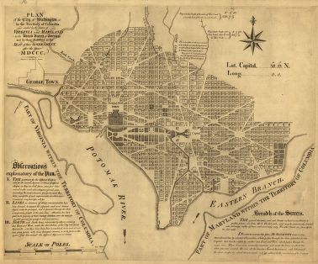
A Frenchman named L'Enfant was hired by Washington to design plans for the capital. At the request of Thomas Jefferson, Washington hired Banneker to serve on the planning committee. One day, after a heated argument, L'Enfant walk off the job taking the plans for the capital with him.
Banneker was able to reproduce
totally from memory in two days
all of the plans for the capital.
His plans included a complete layout of all the streets, parks,
and buildings that were in the original plans. Needless to say,
Washington D. C. would not be as it is today had it not been for
Benjamin Banneker and his eye for detail.

Slide 11
Just for fun, here is a little puzzle by Banneker -- he was fond of things like this:
The Puzzle of the Cooper and the Vintner
A cooper and a vintner sat down for a talk, Both being so groggy that neither could walk; Says cooper to vintner, "I'm the first of my trade, There's no kind of vessel but what I have made, And of any shape, sir, just what you will, And of any size, sir, from a tun to a gill." "Then,"says the vintner, "you're the man for me. Make me a vessel, if we can agree, The top and the bottom diameter define, To bear that proportion as fifteen to nine, Thirty-five inches are just what I crave, No more and no less in the depth will I have; Just thirty-nine gallons this vessel must hold, Then I will reward you with silver or gold -- Give me your promise, my honest old friend." "I'll make it tomorrow, that you may depend!" So, the next day, the cooper, his work to discharge, Soon made the new vessel, but made it too large; He took out some staves, which made it too small, And then cursed the vessel, the vintner, and all. He beat on his breast, "By the powers" he swore He never would work at his trade any more. Now, my worthy friend, find out if you can, The vessel's dimensions, and comfort the man!

Slide 12
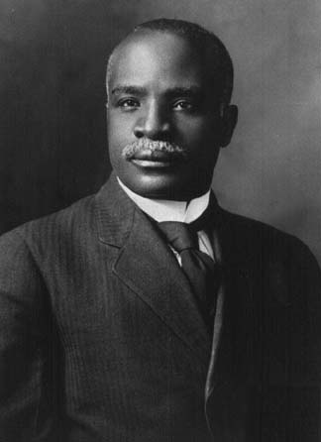
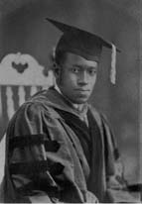
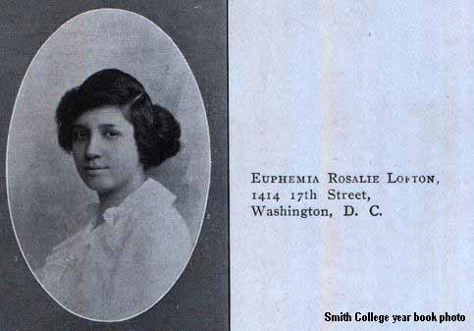
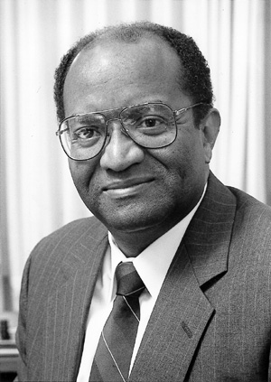
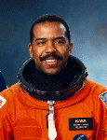
Banneker's life is inspirational. Despite the popular prejudices of his times, the man was quite unwilling to let his race or his age hinder in any way his thirst for intellectual development.
Kelly Miller
Elbert F. Cox
Other Great Mathematicians
Martha Euphemia Lofton Haynes
in 1887, the first Black mathematics graduate student
first Black Mathematics
Ph.D. (1925) Cornell University
Ph.D. (Mathematics) Catholic University, 1943
first African American woman mathematician
Percy Pierre
Dr. Bernard Harris, Jr.
Doctor of Science in Electrical
Engineering from Johns
Hopkins University (1967)
1st African-American to
Walk in Space , NASA

Slide 13
This powerpoint was kindly donated to www.worldofteaching.com
http://www.worldofteaching.com is home to over a thousand powerpoints submitted by teachers. This is a completely free site and requires no registration. Please visit and I hope it will help in your teaching.

